Slide 1
Tanzania 2023
First of all, many thanks from Diocese leadership and the pastors to the Partnership for all of the funds that have come in these last months for hunger, healthcare, water and education- to mention a few.

Slide 2
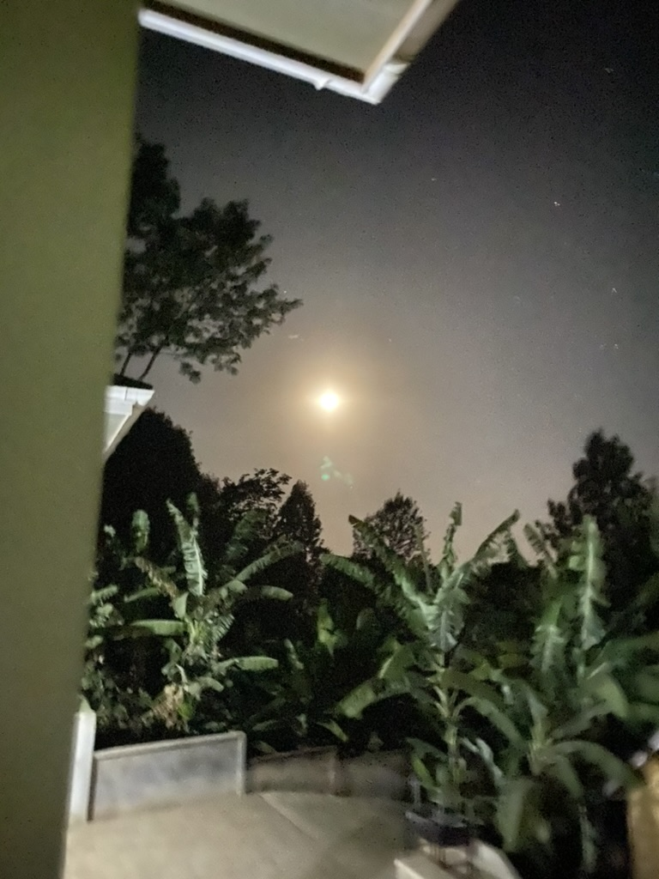

Slide 3
There is so much beauty in Tanzania, but there has also been huge effects from the ongoing drought, even for the animals, both farm and wild.

Slide 5
This was my 3rd visit in the past year. When in Meru, in December, on behalf of Medical Support, I presented the possibility that someone from the Partnership should have the opportunity to interact with some of the German partners who work with them. At that time, they asked me to represent our partnership in the United States.

Slide 8
The group that I focused on is Feuerkinder. It is a foundation that has supported pediatric orthopedic surgeries generally presented through the Rehabilitation Center.
Dr AnnMarie Schraml has been coming for 23 years.
In their first week - 3 surgeons in a team of about 10 did 51 procedures. They bring pallets of supplies to do these surgeries.

Slide 9
This child has a birth defect of his left arm. He was referred to Dr Schraml’s clinic.

Slide 10
She expressed willingness to continue to communicate with us and is willing to share. Not sure, at this point, if they can take on another building project. They utilize the Snowball Effect for all of their fund-raising. (no candy sales or auctions- they tell the stories and keep finding individuals and groups to listen) She is interested in learning what the cost of a new outpatient and emergency unit would be, its location, etc.

Slide 11
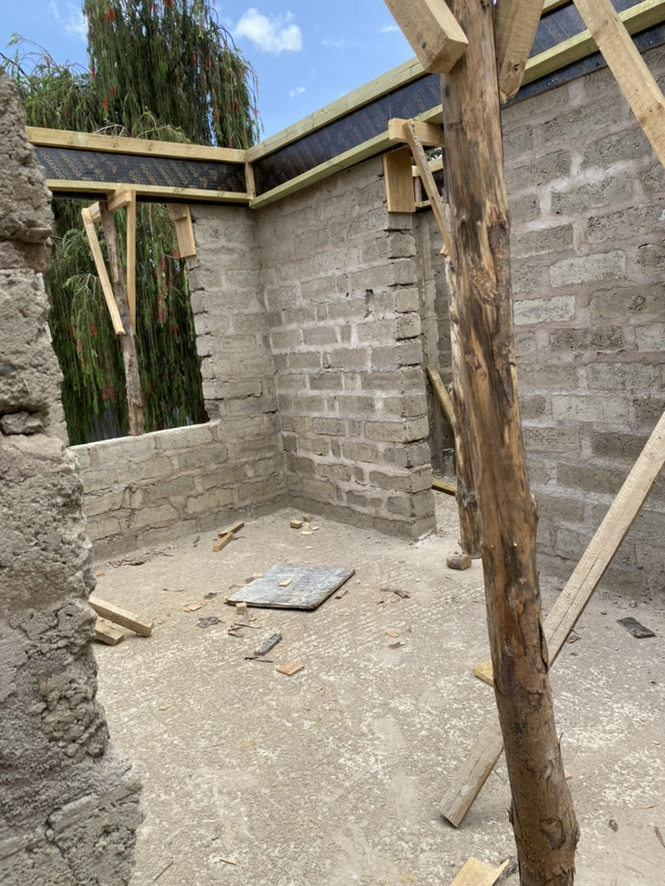
They dedicated the surgical suites at the beginning of last year and are currently building this new maternity wing- both are at Nkoaranga.

Slide 12
The HR director from the Diocese took me into the commercial building owned by the Diocese. The second floor has larger spaces. They are hoping to attract banks and/or other professional services. We climbed through the window to look at the space. Lots of windows for light, but only 4 outlets.

Slide 16
Dispensaries are struggling. Kikatiti has probably its third Dr. in the last couple of years. I did get to Ngarenanyuki. They are a very devoted staff, with a clean space, but lacking supplies and medications. We were able to stock their shelves to encourage patients to come for complete services. Currently there is no running water for the facility.

Slide 19
As it turns out, there are 2 separate groups from Germany. The second one has been key in redoing the Leguruki facility to make it a health center- a water system, maternity building, surgical suites- plus women’s and men’s beds for post operative care. They say it will be open soon, but there are still supplies and equipment needed and the post operative areas were not complete. TZ time.

Slide 21
As I have mentioned before, the Palliative Care team is a great adjunct to the hospital. Dr. Bakari and his staff see many patients per month. This is a homecare patient that we visited.

Slide 22
When visiting Mshikamano Vocational School, I learned that they are now only teaching skills for the hotel/tourism industries. I observed the cooking class. The teachers had about 25 students and one tabletop 2 burner stove. Difficult for learning. I spent some time with Magdelena- the administrator, and 2 of the teachers. I also got to pet their pigs. They raise them to help support the school.

Slide 26
One day I was invited to a church group of about 27 women and 3 men. They beat their drum, sang and danced for us. They make batiks, beaded jewelry, beaded shukas and grow some coffee. I was able to purchase things from them. The money they make helps to support their parish and their families. At Redeemer, we used the batik shawls for a Mother’s Day fundraiser for our TZ missions.

Slide 29
Pictured are some of the chickens from the hatching project that this HIV Support group is running. It has taken a couple years, but it is becoming a good process. Electricity loss does affect their productivity and the solar backup only goes so long.

Slide 30
The bishop’s wife and I went on a private safari and saw a lot of animals- elephants, a spotted white leopard and many more. It was terribly dry at the Saturday Masai market, but very busy. We also saw men carving elephants from ebony wood. Everywhere you can see the contrast between the old and new worlds.

Slide 33
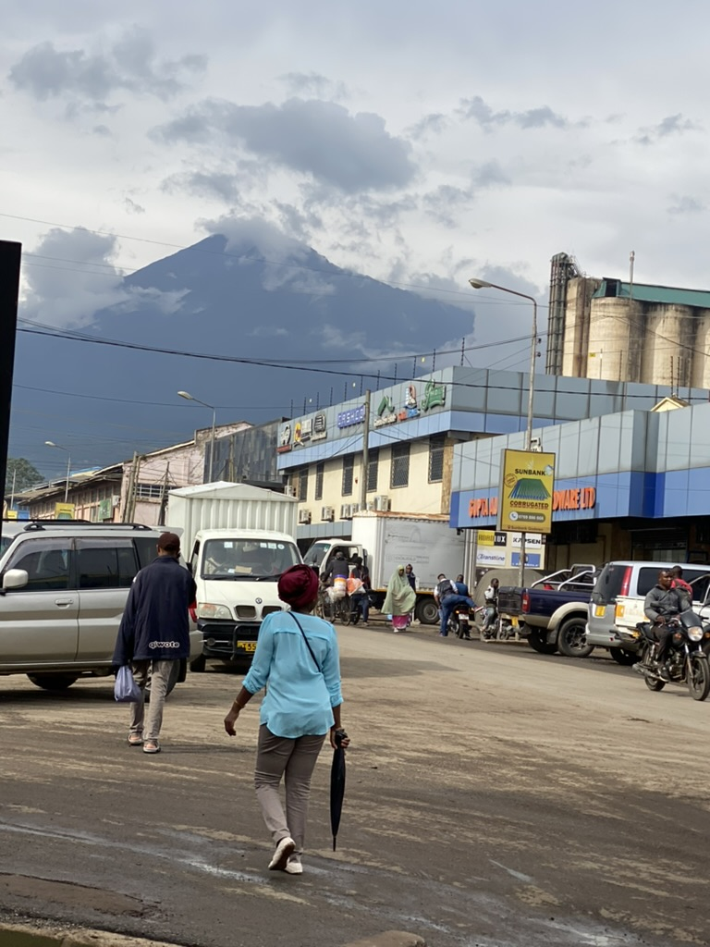

Slide 35
As the world celebrated International Women’s Day, we celebrated it at church. Most of the women had matching or contrasting dresses. The women did the whole service and still did all of the cooking.

Slide 36
As I said before, you can find beauty almost everywhere you look, but in between, there are needs that we can consider.
God’s Work, Our Hands remains relevant, as long as our brothers and sister also see the need….

Slide 37
God’s Work, Our Hands- What’s Next?
*Hunger/Drought –
Overshadows everything. Most evident in the South
*Plans for OP/ER –
$8000 to determine feasibility and cost of the project
*Dispensaries -
Salaries/ Medications/ Supplies
*Mshikamano Vocational School –
4 stoves needed for the culinary program- $1360 (has been pledged)
*HIV Support –
Generator to support hatcher with electricity lapses- $600-800

